Slide 1

Large-Scale and Multi-Structured Databases EasyDrugs
Nilo Fabiano
Lorenzo Valtriani
Samuele Marchi

Slide 2
Application Highlights
EasyDrugs aim to create a diverse ecosystem where Patients, Doctors, Pharmacies and Researcher can help one another, both directly and indirectly,
through services and information sharing
Functionalities:
Browse drugs
Make and store prescriptions
Store the purchased drugs
Get statistics on medical environment

Slide 3
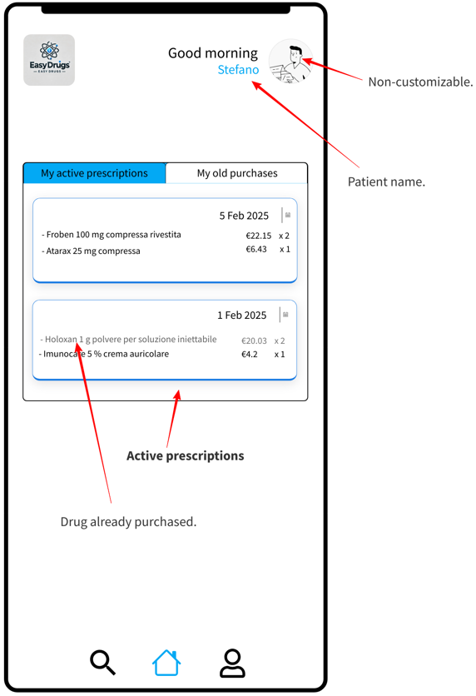
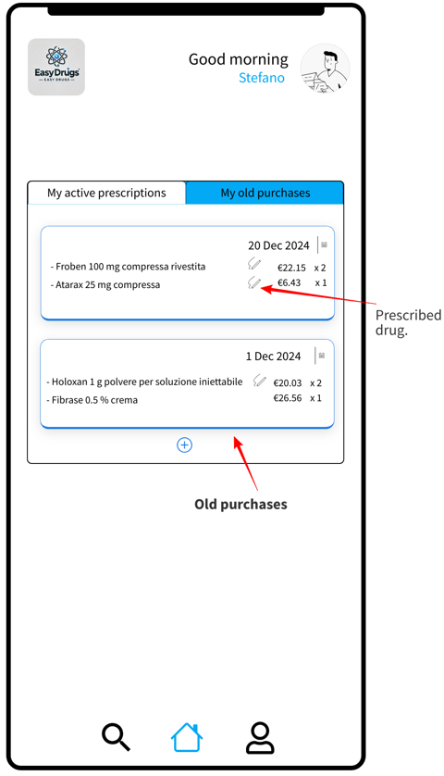
Actors (Patient)

Slide 4
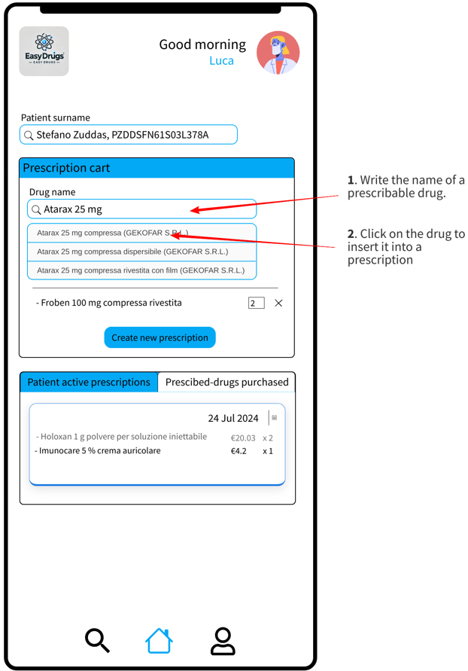
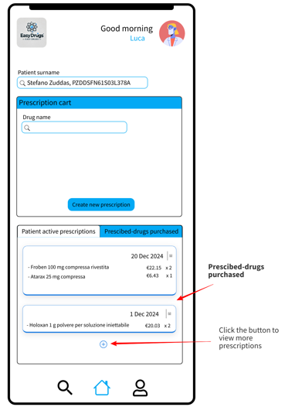
Actors (Doctor)

Slide 5
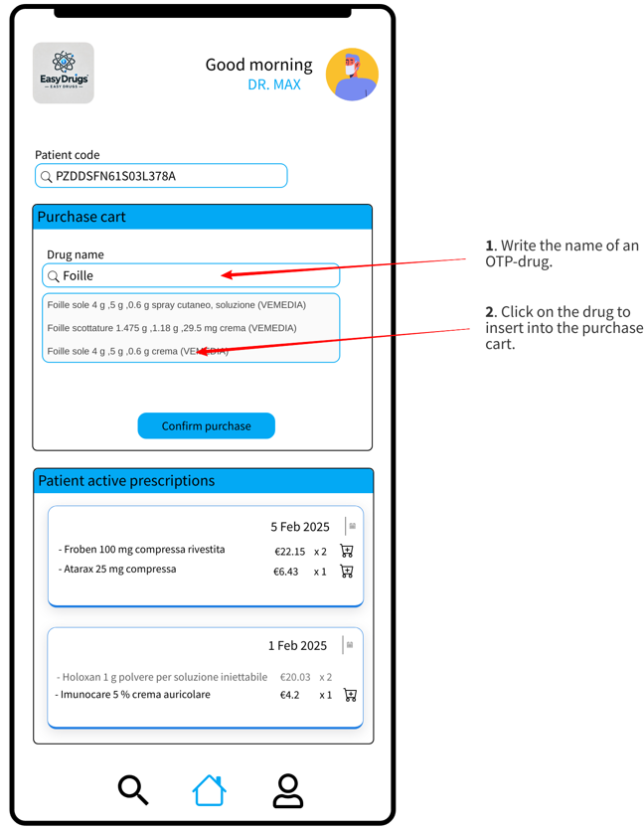
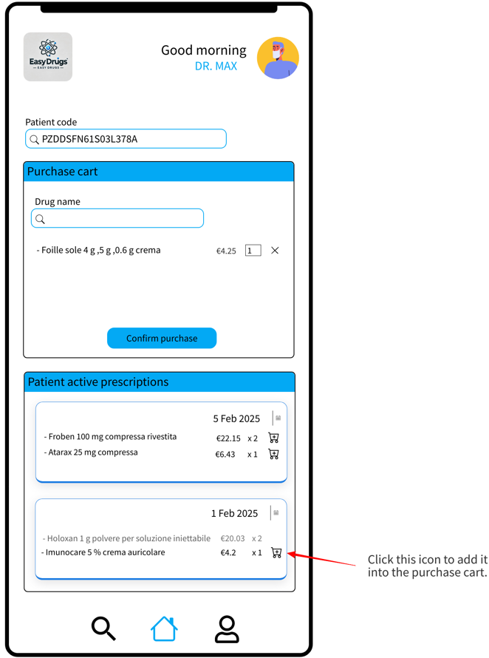
Actors (Pharmacy)

Slide 6
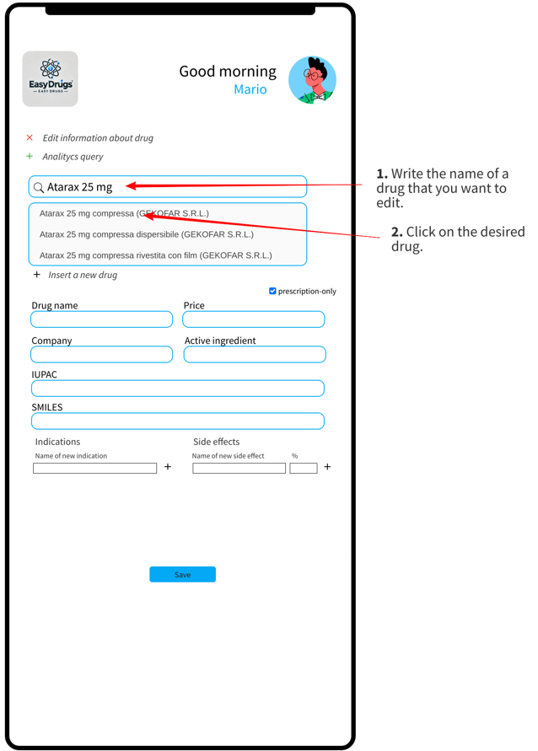
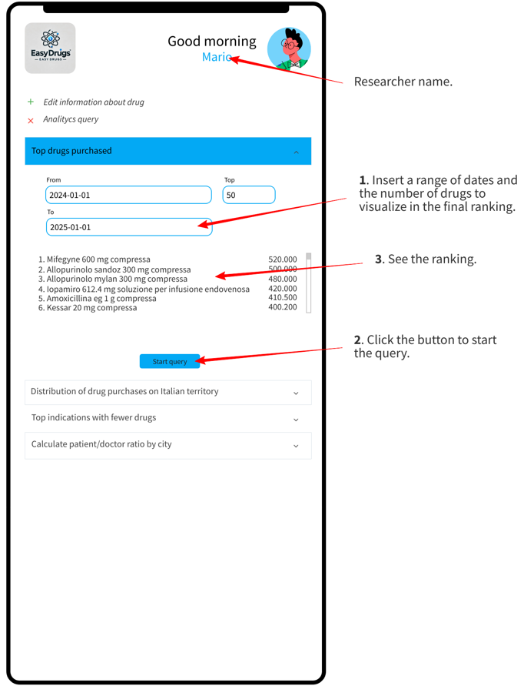
Actors (Researcher)

Slide 7
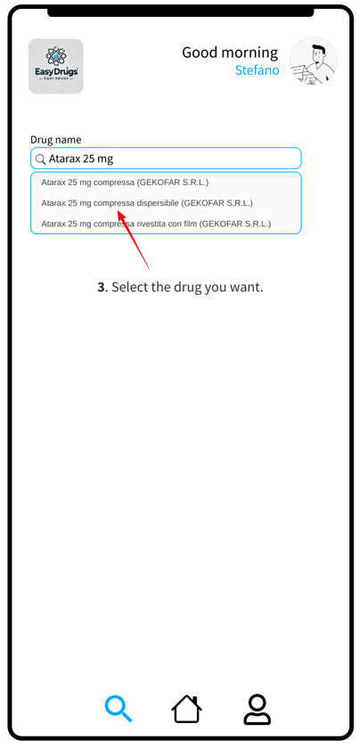
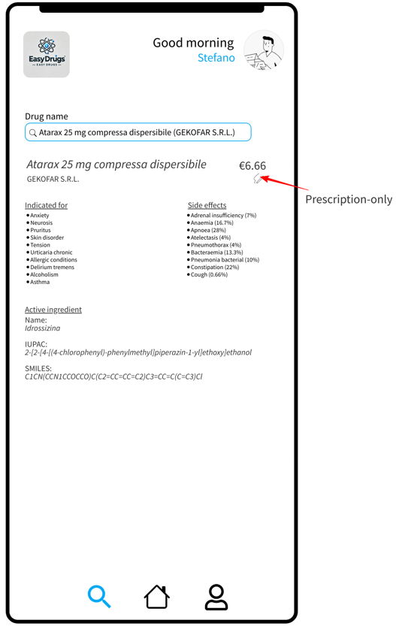
Actors (User)

Slide 8
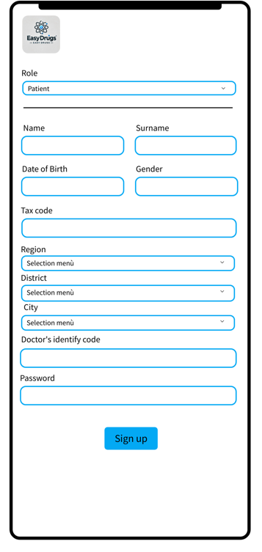
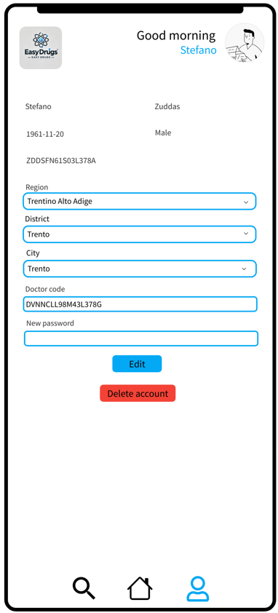
Actors (User)

Slide 9
Dataset Description
Italian Ministery of Health Open Data, AIFA open data,The Medicines Utilisation Monitoring Centre, Pubchem, SIDER, ISTAT, AGENAS, AdminStat, Federfarma, Datiopen.it, public github repositories.
Sources:
Description:
First five sources for drugs information, github repositories to generate Italian names and surnames and the rest for a realistic account generation and other statistical information about drug consumption.
Pre-processing:
1) Web-scraping on AIFA 2) Merge datasets 3) Generation of accounts 4) Binding data into collections 5) data sanitization.
Volume:
192,42 MB.
Variety:
12 different sources, about 10 datasets and 5 reports to represent a realistic environment in 6 collections.
Velocity/Variability:
6Mln of payments a day in register of purchases.

Slide 10
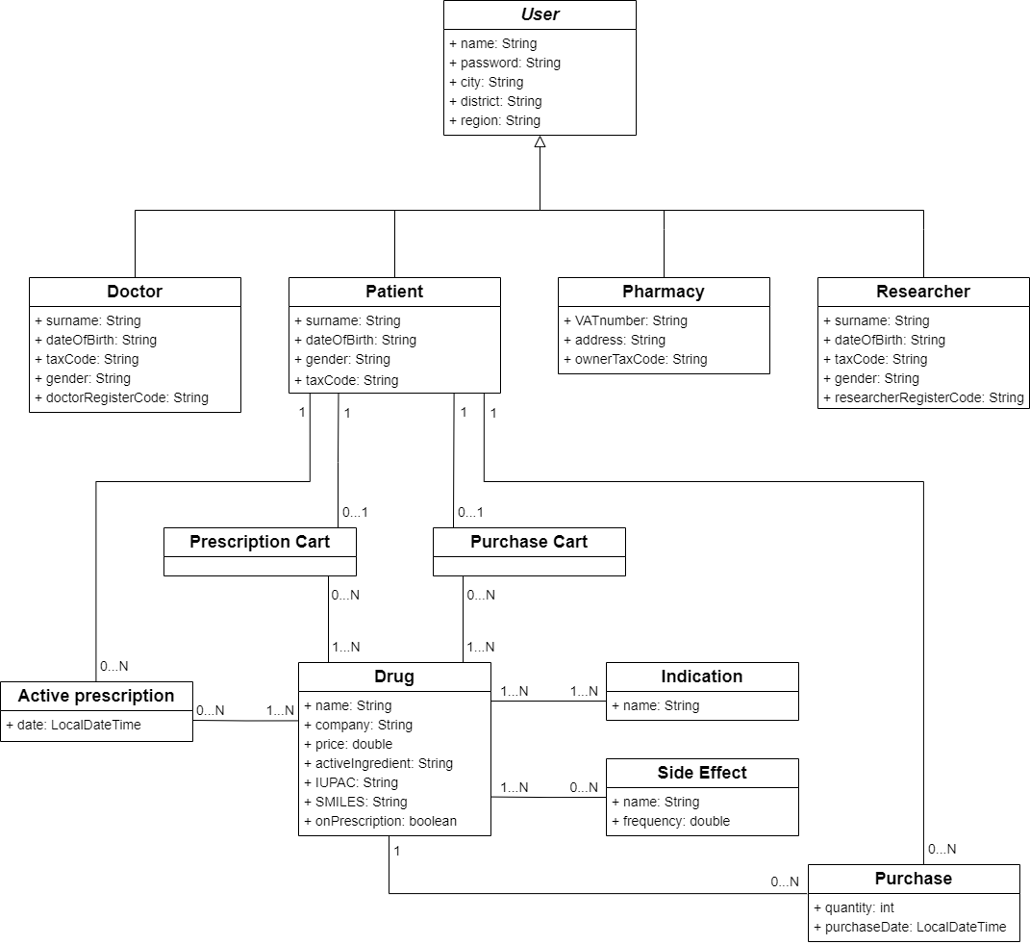
UML Design Class Diagram

Slide 11
Application non-functional requirements
The system must be implemented as PWA (progressive web app)
The system must be intuitive and user-friendly without requiring specific training
The system must be developed using an object-oriented programming language
The system must ensure high availability
The system must ensure partition tolerance
The system must be able to store and quickly query a large volume of data
The system must ensure data integrity in case of a crash
The system must ensure inter-database consistency
The system must store all active prescriptions in the key-value database for one month
The system must store all drugs in the prescription cart in the key-value database for one day
The system must store all drugs in the purchase cart in the key-value database for one hour
The system must encrypt passwords with actual security standard

Slide 12
CAP theorem
Partition Tolerance
Consistency
AP
Availability

Slide 13



Databases
Store temporary attributes
Simple queries
Simple data models
Fast data access
Low query response time
Store and elaborate large amount of data
Complex queries
Huge flexibility
Horizontal scalability

Slide 14
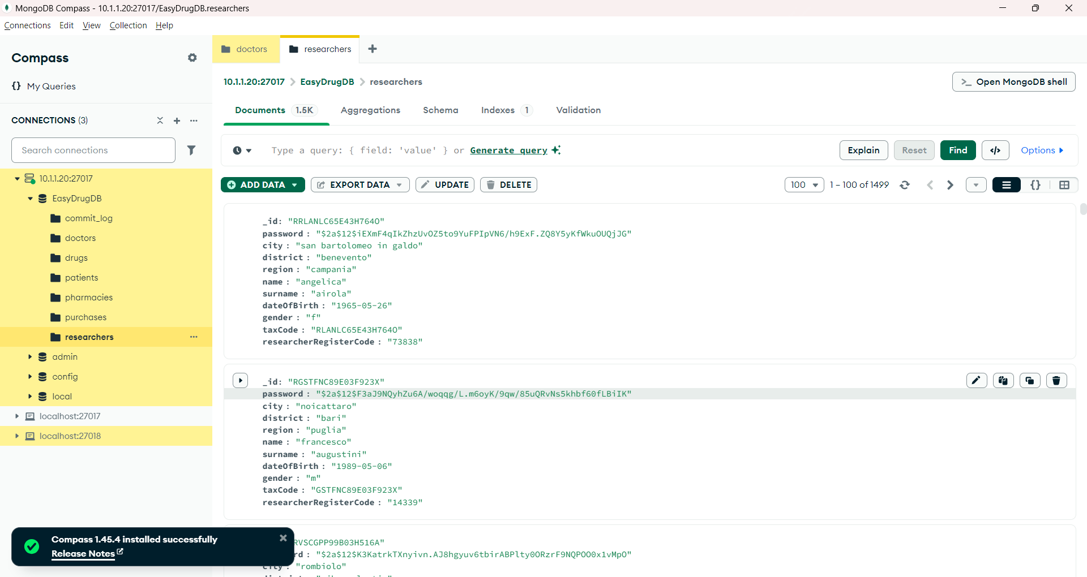
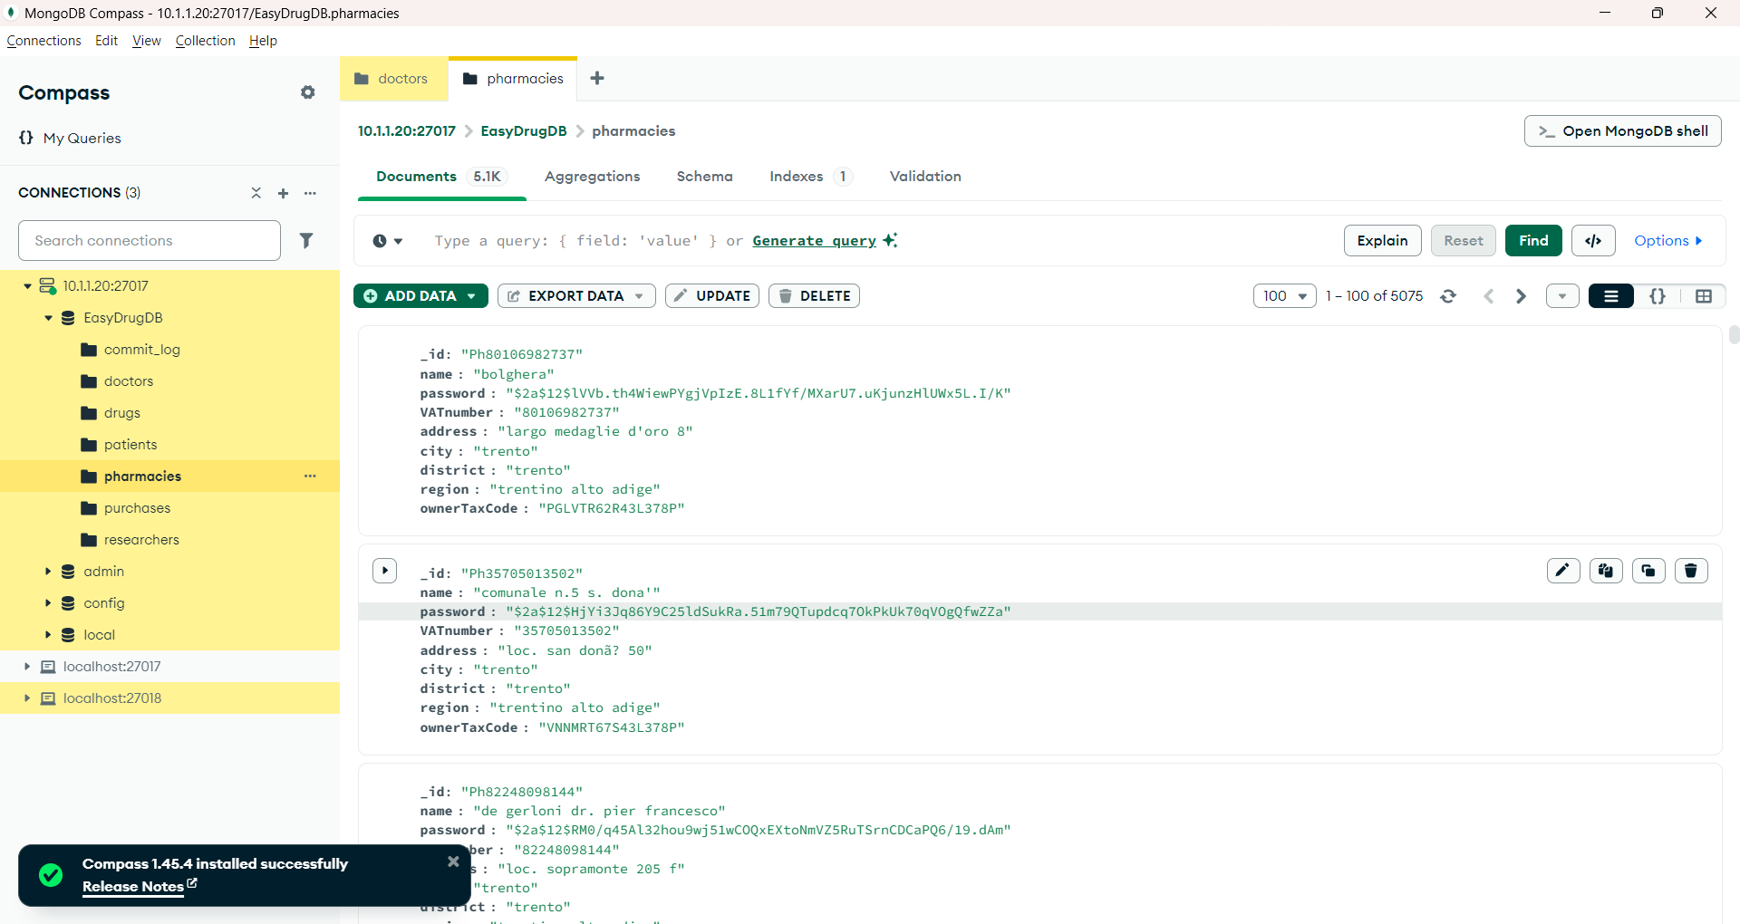
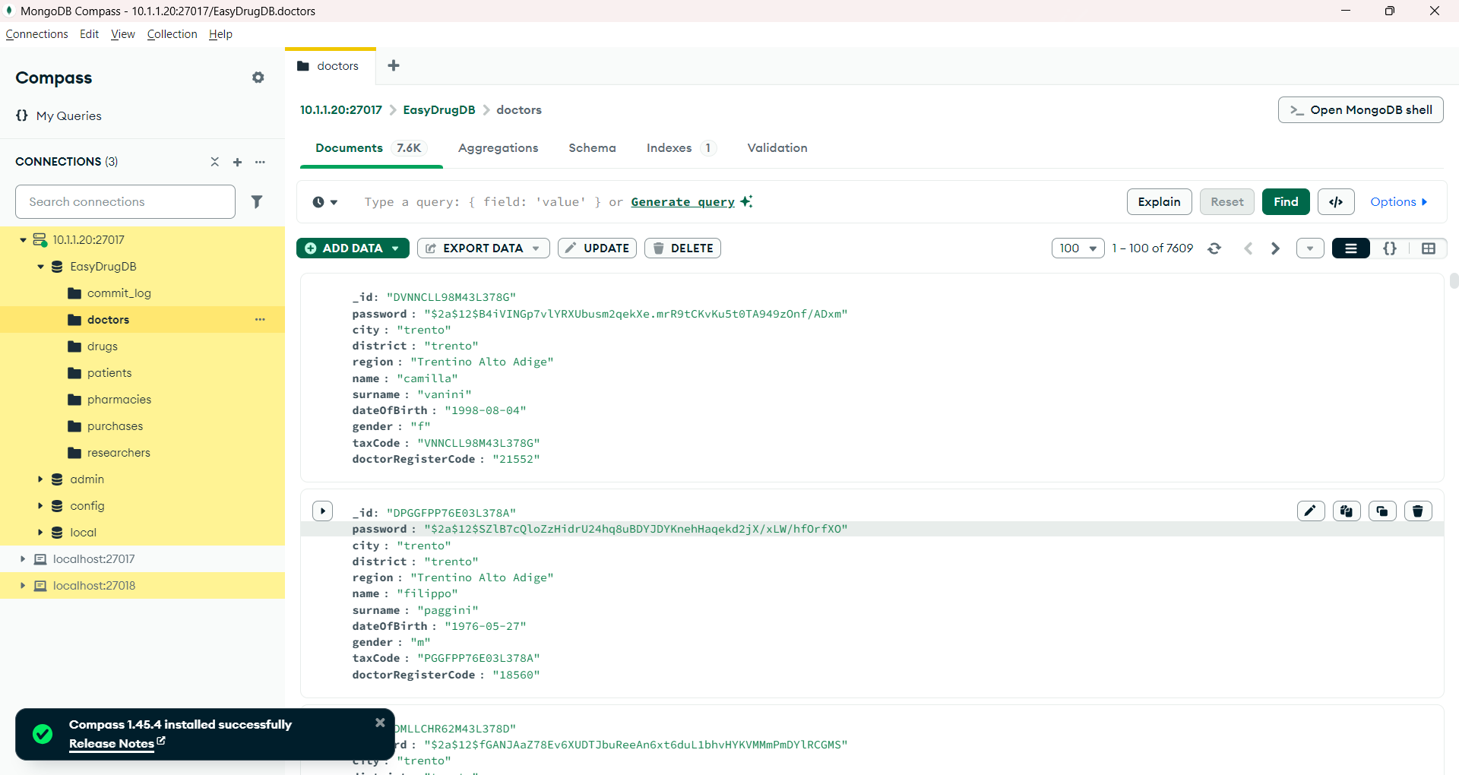
Document DB Design (i)
Pharmacies Collection
Doctors Collection
Researchers Collection

Slide 15
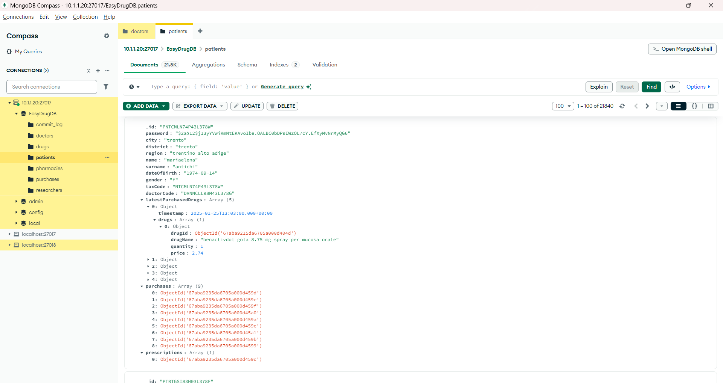
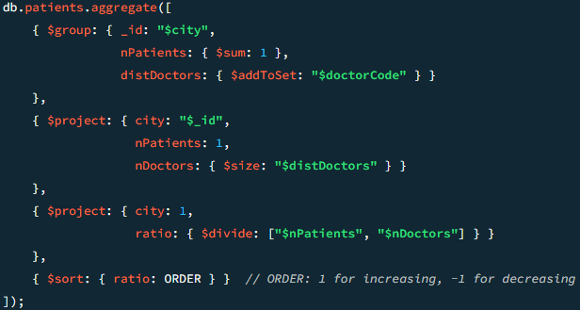
Document DB Design (i)
Patients Collection
Patient-to-Doctor Ratio by City

Slide 16
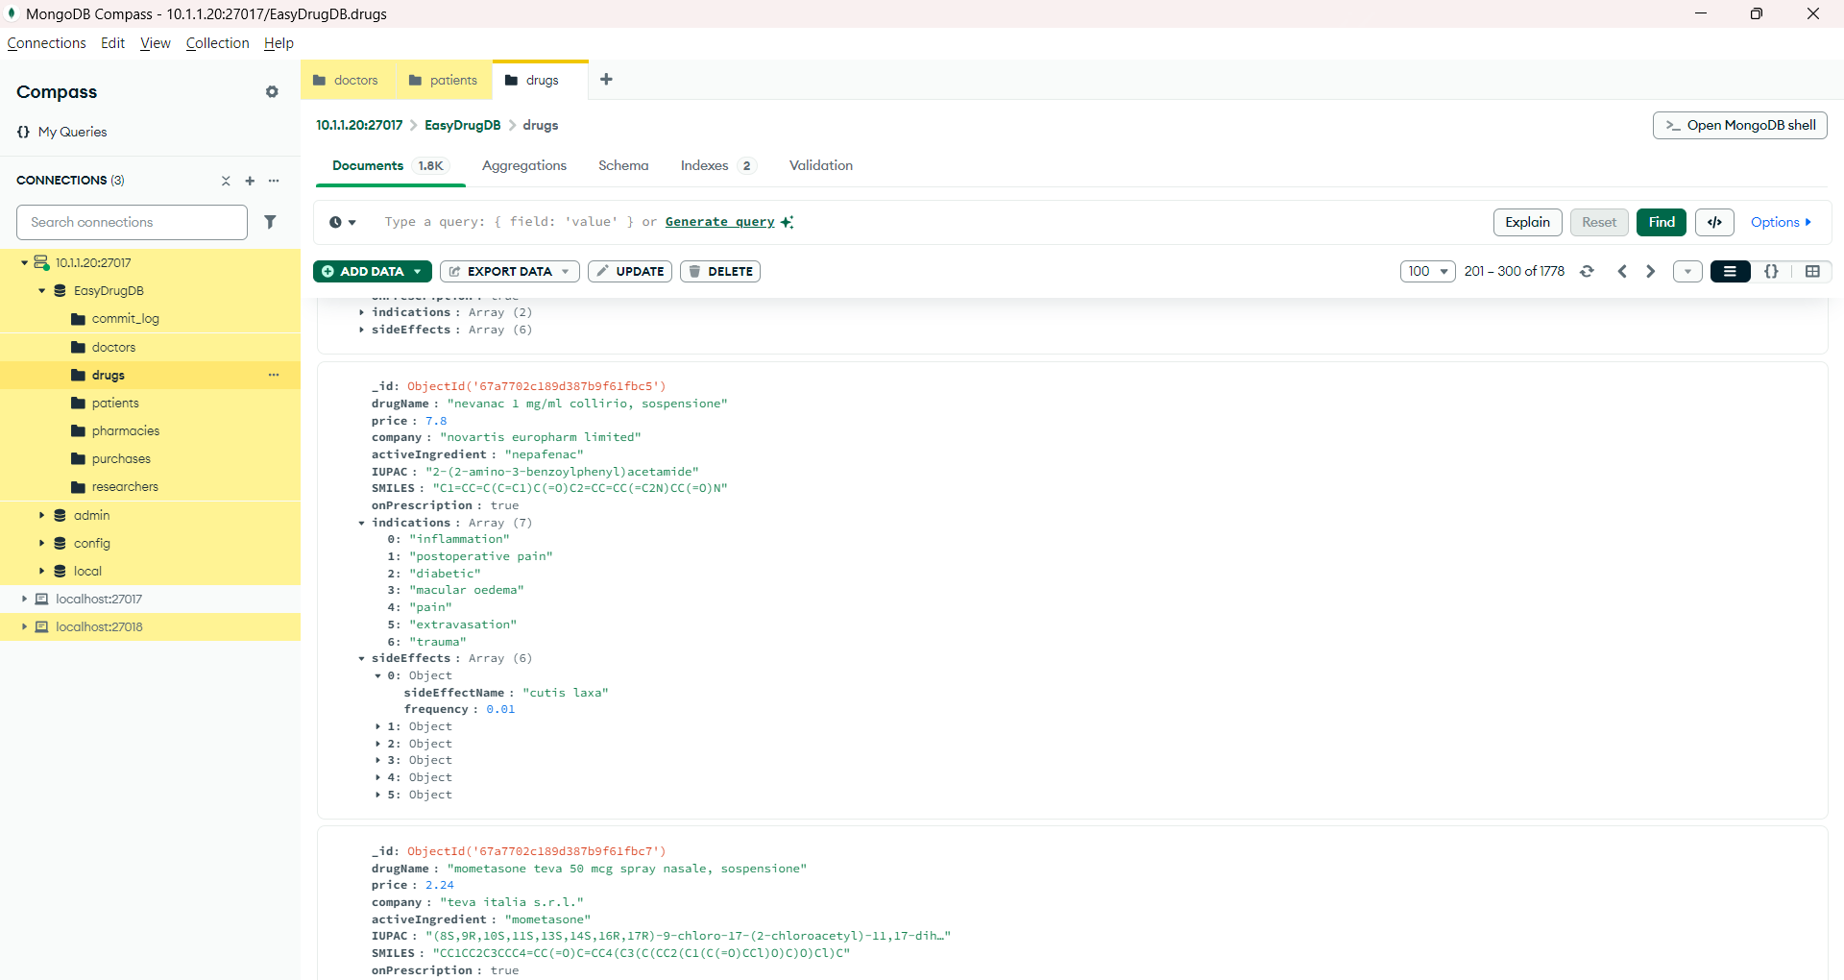
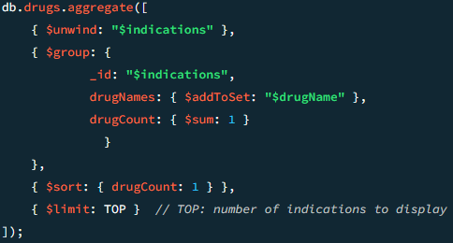
Document DB Design (ii)
Drugs Collections
Retrieving Indications with Fewer drugs

Slide 17
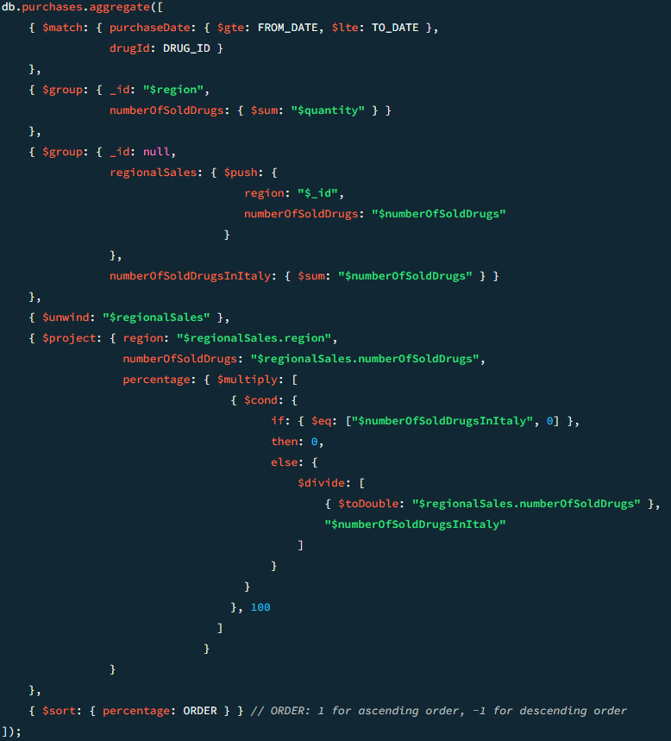
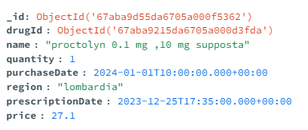
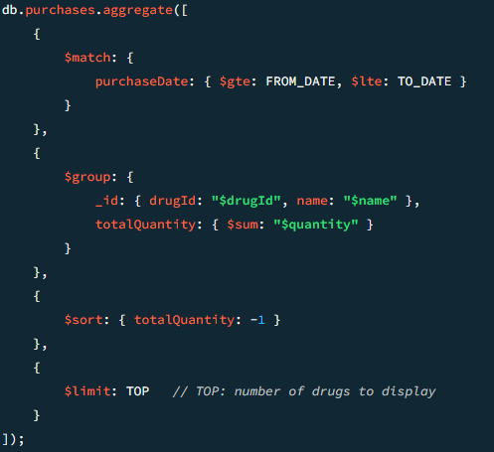
Document DB Design (iii)
Purchases Collections
Retrieving the most Purchased drugs
Geographical Distribution of drug Purchases

Slide 18
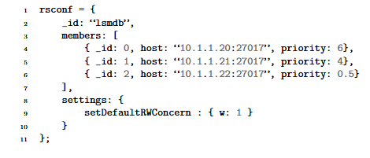
MongoDB Replica Set Configuration
Replication structure
Primary Node: IP 10.1.1.20
Replicas: IPs 10.1.1.21, 10.1.1.22
Write Concern = 1
quick response time
eventual consistency
Read Preference = nearest
reduce query latency
balance of network’s throughput
Replica Set configuration
mongodb://10.1.1.20:27017,10.1.1.21:27017,10.1.1.22:27017/EasyDrugDB?replicaSet=lsmdb&readPreference=nearest

Slide 19
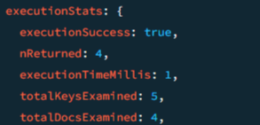
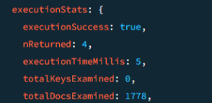
MongoDB Indexes
Collection: drugs
Code: @CompoundIndex(def=”{‘drugName’:1, ‘onPrescription’:1}”)
Affected Queries: list of drugs by prefix, list of OTC by prefix, list of prescribable drugs by prefix
Example query:
db["drugs"].find({ drugName : { $regex:'^caspofungin'},onPrescription : true }).explain("executionStats");
With index:
Without:

Slide 20
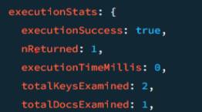
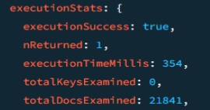
MongoDB Indexes
Collection: patients
Code: @CompoundIndex(def=”{‘doctorCode’:1, ‘surname’:1}”)
Affected Queries: list of patient by prefix
Example query:
db.patients.find({ 'doctorCode': 'DVNNCLL98M43L378G',
'surname' : { $regex: '^zudd' }}).explain(“executionStats”)
With index:
Without:

Slide 21
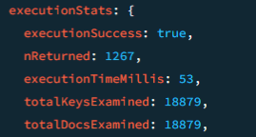
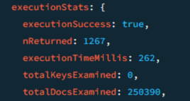
MongoDB Indexes
Collection: purchases
Code: @Indexed({'purchaseDate': 1})
Affected Queries: most purchased drugs by period, purchase of drug for region by period stats
Example query: db.purchases.find({ purchaseDate: { $gte:ISODate("2024-01-01T10:00:00.000Z"),$lte:ISODate("2024-01-31T10:00:00.000Z")},drugId:ObjectId('67aba9215da6705a000d3fda')}).explain("executionStats")
With index:
Without:

Slide 22
Discussion on MongoDB Data Sharding
Patients collection: Hashed on doctorCode
The system must allow doctors to search for patients by surname prefix
Drugs collection: Range-Based on drugName
The system must allow users to view a list of drugs by entering a name prefix.
Purchases collection: Hashed on region
The system must allow patients to view their purchased drugs in groups of ten, sorted by the most recent first.
Doctors, researchers and pharmacies collection: Hashed on _id
NFR: The system must be able to store and quickly query a large volume of data.

Slide 23
Key-value DB Design
Show the Redis data model (which names have been chosen for keys? Which values are stored within keys?) and justify choices.
Show the implemented queries highlighting how the system benefits from the proposed DB design.
If needed, make also reference to the Mock-ups (for the view supported by the designed key)
visualizzazione carrelli
confirm purchase
active prescription
Use max 3 slides

Slide 24
Key-value DB Design (i)
prescription namespace:
pres:id_pres:id_pat:timestamp
pres:id_pres:id_pat:toPurchase
pres:id_pat:set
ISO-formatted date string
Integer
Set of integers
prescribed drug namespace:
pres-drug:id_pres-drug:id_pres:id
pres-drug:id_pres-drug:id_pres:info
info: { name, price, quantity}
pres-drug:id_pres-drug:id_pres:purchased
pres-drug:id_pres:set
ObjectId
Json
Boolean
Set of integers
purch-drug:purch-drug_id:id_pat:id
purch-drug:purch-drug_id:id_pat:info
info: {name, price, quantity, id_pres, id_pres_drug}
purch-drug:id_pat:set
purchased drug namespace:
ObjectId
Json
Set of integers

Slide 25
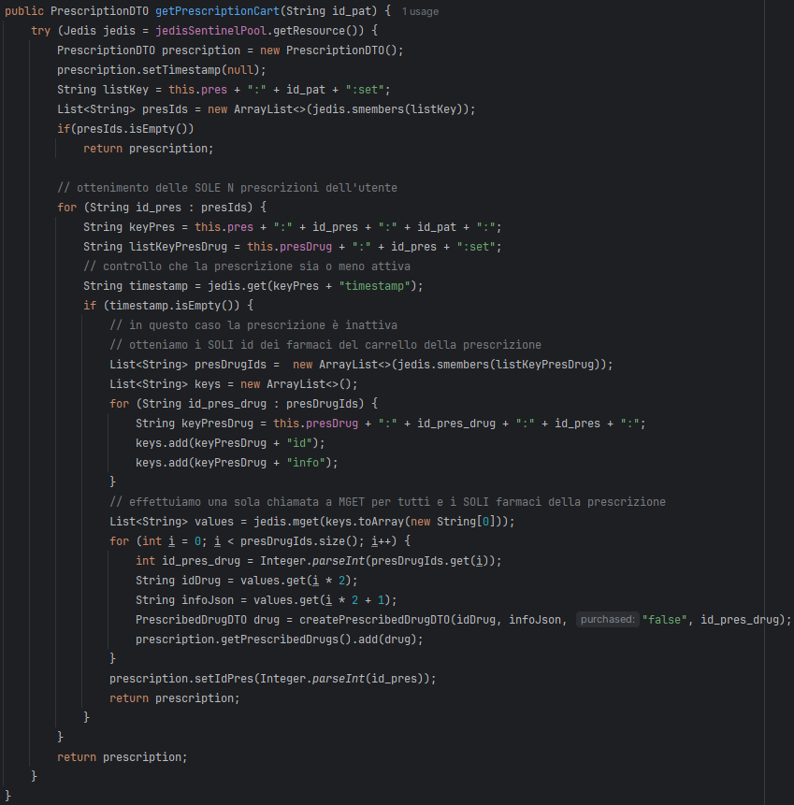
Key-value DB Design (ii)
Retrieve the prescription cart of a specific patient
pres:id_pat:set
pres-drug:id_pres:set
Advantages:
Limited network overload
High scalability

Slide 26
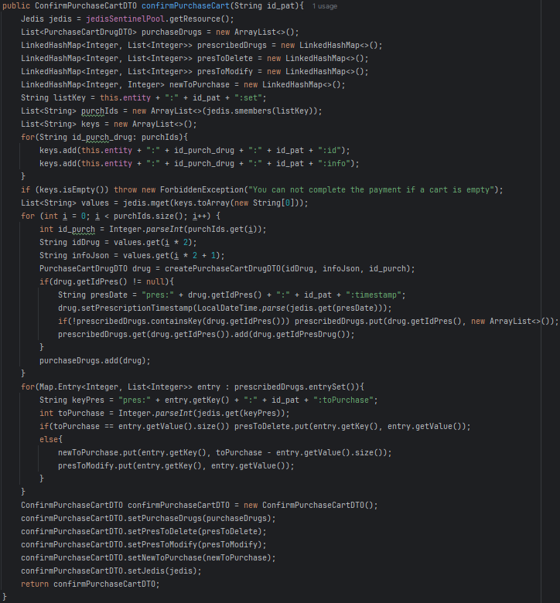
Key-value DB Design (iii)
Confirmation of the purchase of drugs in the cart
purch-drug:id_pat:set
Advantages:
Limited network overload
High scalability

Slide 27
Redis Replica Set Configuration
Eviction policy:
>> maxmemory-policy volatile-ttl
Persistence:
>> appendonly yes
>> appendfsync everysec
>> aof-use-rdb-preamble yes
Redis Cluster:
no

Slide 28
Redis Replica Set Configuration
Replica configuration ( /etc/redis/redis.conf)
Master node: IP 10.1.1.22
Replica nodes: IPs 10.1.1.20, 10.1.1.21
bind 10.1.1.22 -::1
port 6379
[redis.conf of the node .22]
Sentinel configuration (/etc/redis/sentinel.conf)
port 26379
sentinel monitor mymaster 10.1.1.22 6379 2
sentinel down-after-milliseconds mymaster 5000
sentinel failover-timeout mymaster 10000
[sentinel.conf of each node]

Slide 29
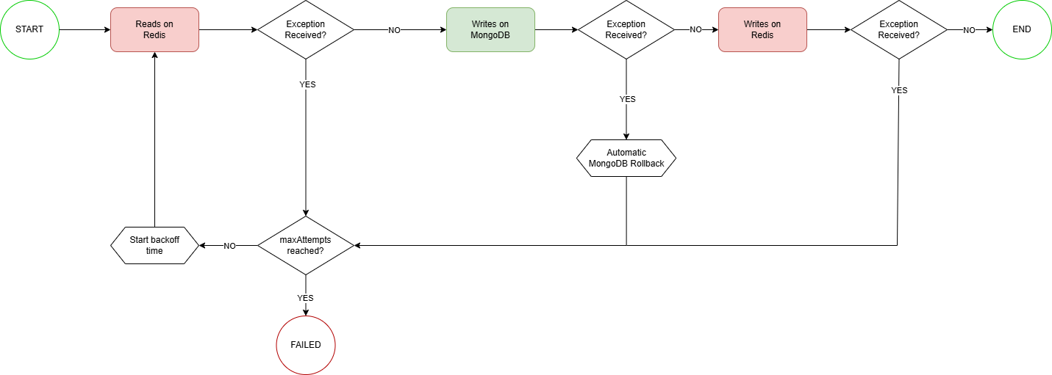
Handling Intra-DB Consistency
The scenario: purchase confirmation
MongoDB fail event
Redis fail event
Lua exception
Crash before writing to aof

Slide 30
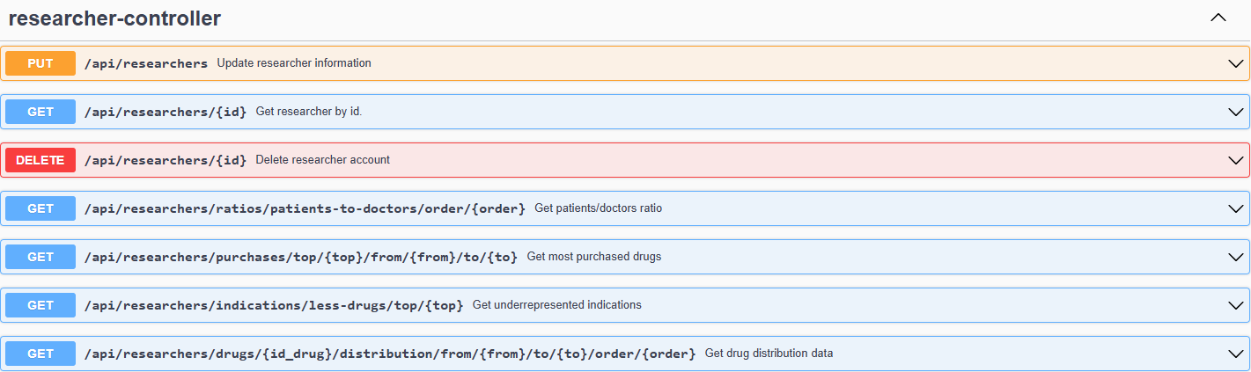
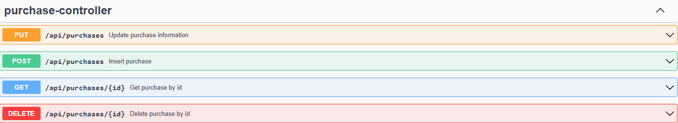
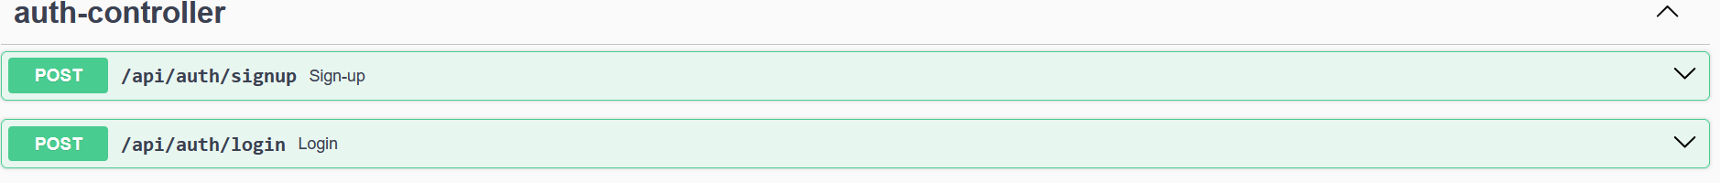
Swagger UI REST APIs documentation

Slide 31
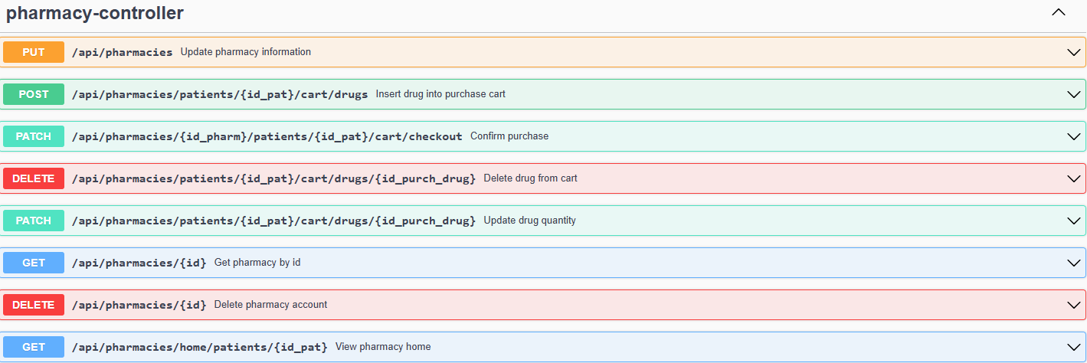
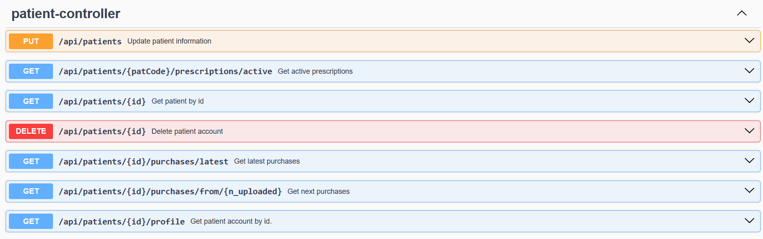
Swagger UI REST APIs documentation

Slide 32
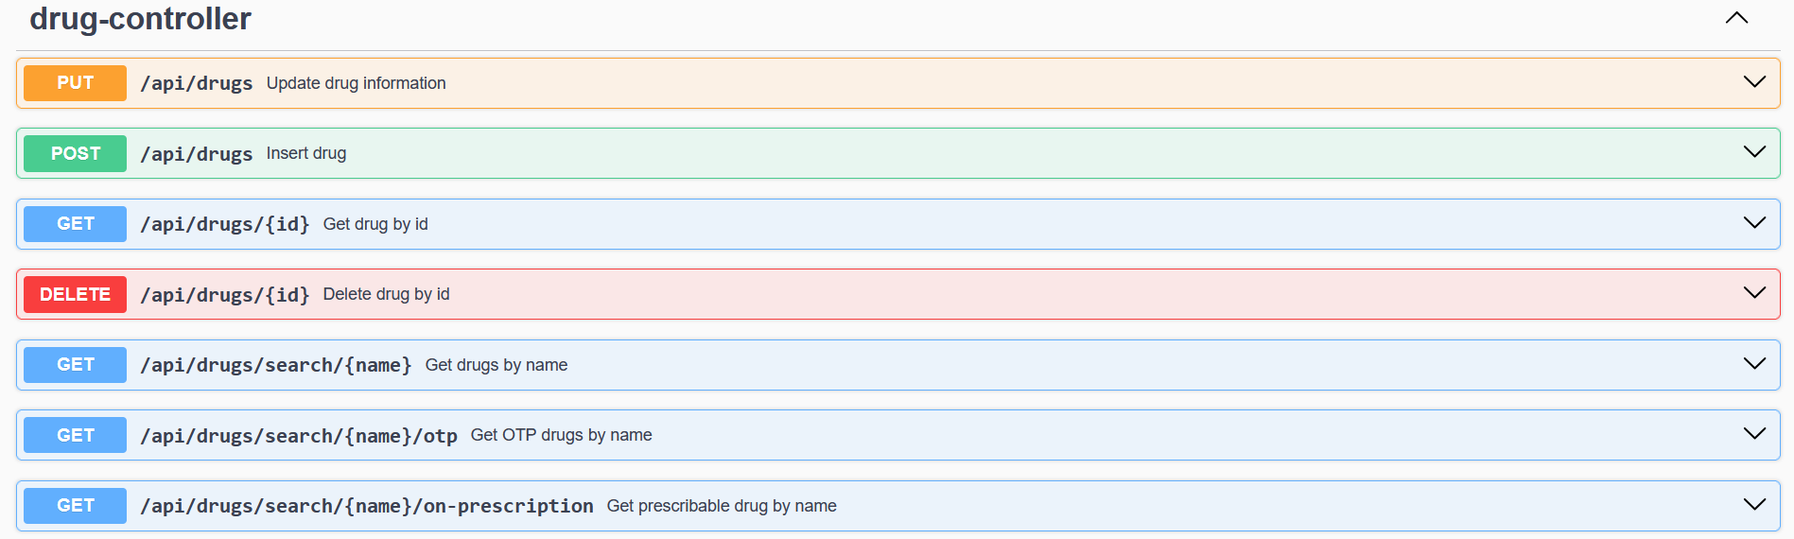
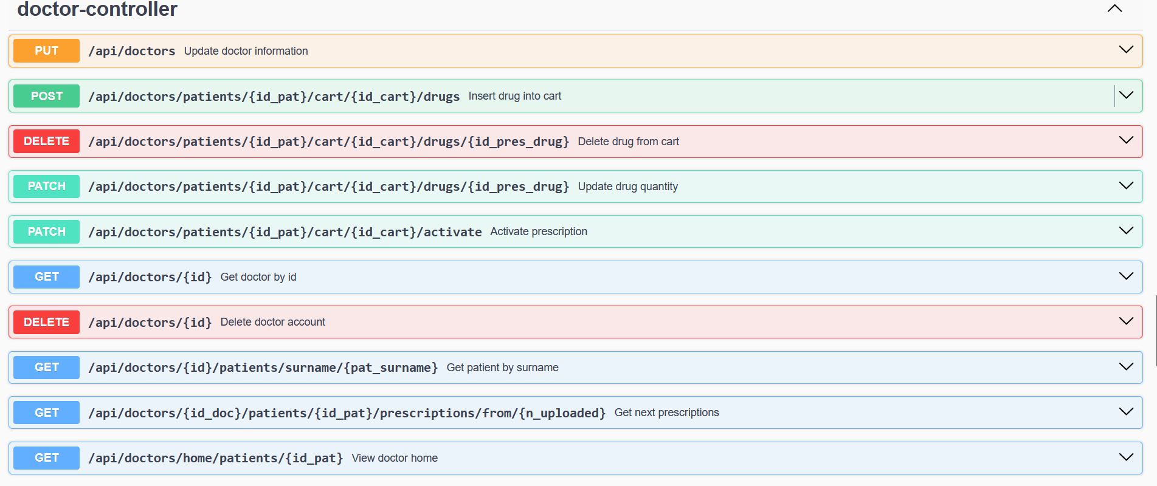
Swagger UI REST APIs documentation

Slide 33
Live Demo with Postman
Show the Postman Collection containing all the REST endpoints exposed by your application (e.g. authentication, product management, analytics, etc.)
Detailed endpoints descriptions: endpoint purpose, required input parameters with example values .
Show live testing of some relevant endpoints of your application within Postman. Also show how error scenarios are handled (bad requests and exceptions; Missing or invalid parameters; Unauthorized access attempts; Endpoint-specific edge cases (e.g., trying to fetch a non-existent resource).

Slide 34
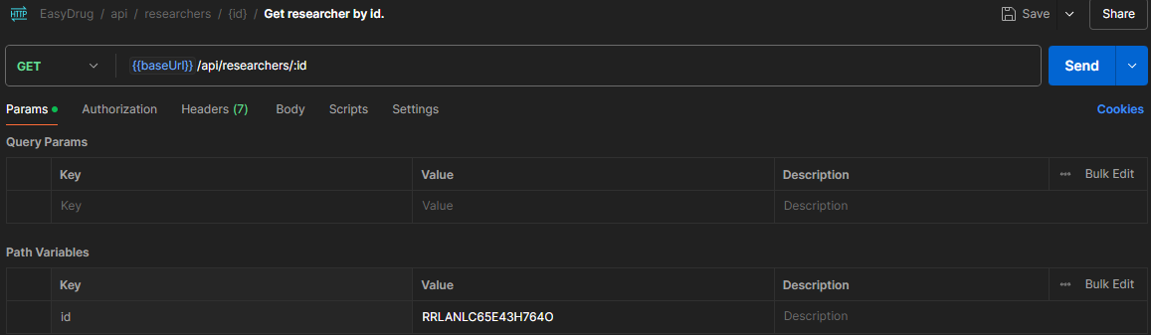
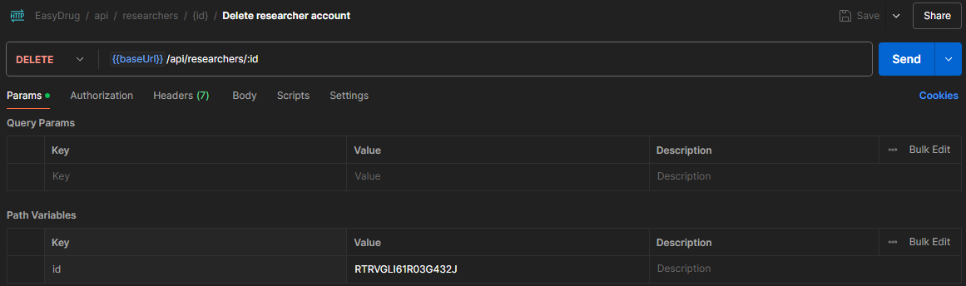
Live Demo with Postman

Slide 35
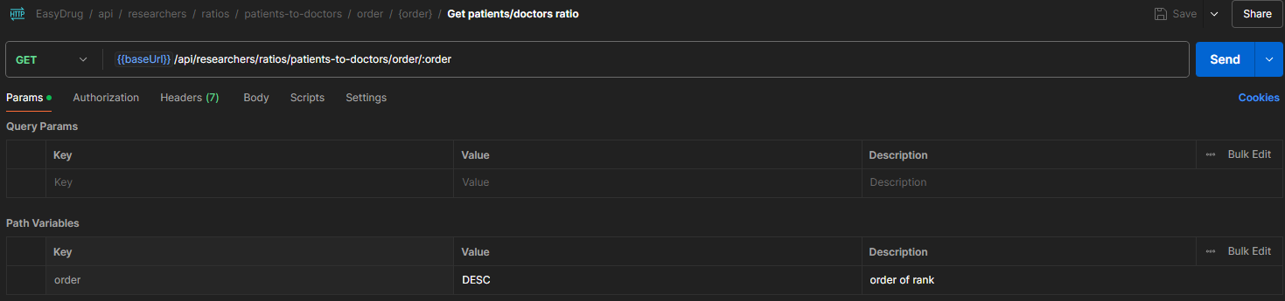
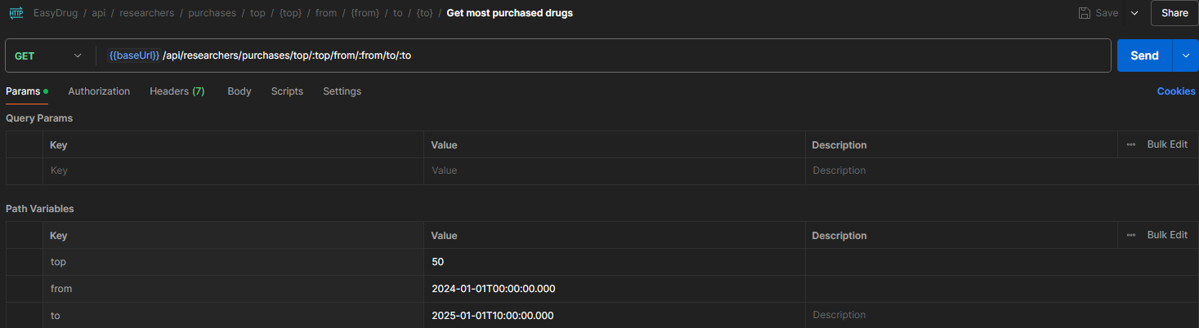
Live Demo with Postman

Slide 36
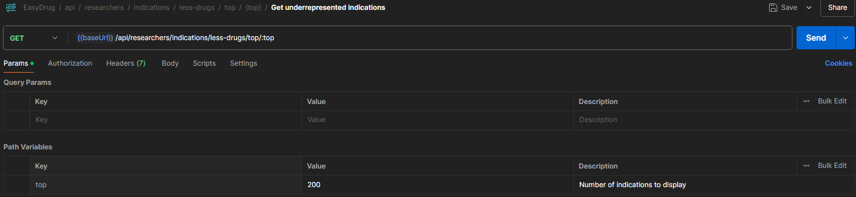
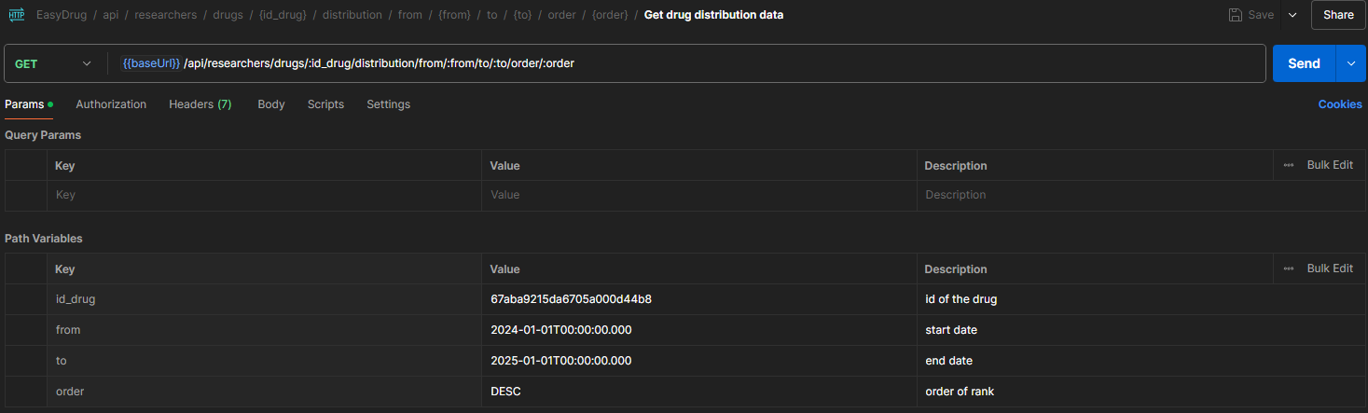
Live Demo with Postman

Slide 37
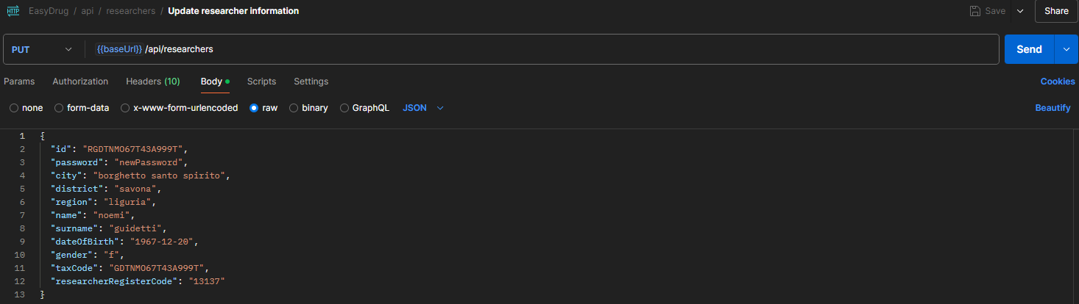
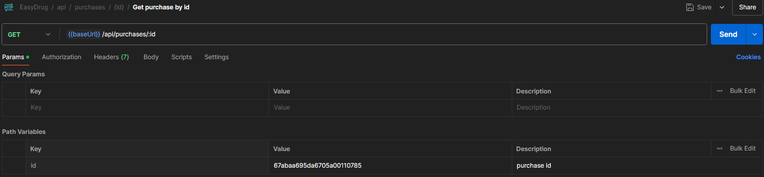
Live Demo with Postman

Slide 38
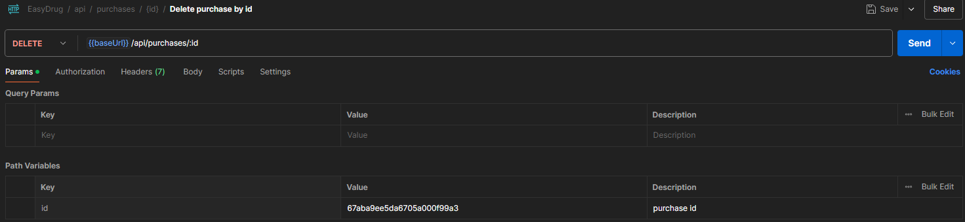
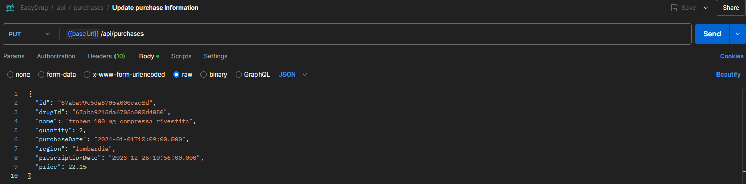
Live Demo with Postman

Slide 39


Live Demo with Postman

Slide 40


Live Demo with Postman
Body: updated quantity

Slide 41


Live Demo with Postman

Slide 42


Live Demo with Postman

Slide 43


Live Demo with Postman

Slide 44

Live Demo with Postman

